Slide 1
MACHINING SCIENCE AND MACHINE TOOLS
MODULE 2

Slide 2
MACHINE TOOLS
A machine tool is defined as one which while holding the cutting tools would be able to remove metal from a work piece in order to generate the requisite product of given size, configuration and finish.
It is different from a machine, which essentially is a means of converting the source of power from one form to the other.
The machine tools are the mother machines since without them no components could be produced in their finished form. They are very old and the industrial revolution owes its success to a very great extent to them.

Slide 3
CLASSIFICATION OF MACHINE TOOLS
1. General purpose machine tools (GPM)
those designed to perform a variety of machining operations on wide ranging types of components. By the very nature of generalisation, the general purpose machine tool though capable of carrying out a variety of tasks, would not be suitable for large production, since the time for setting-up such operations is large.
Thus the idle time on the general purpose machine tool is more and the machine utilisation is poor. The machine utilisation may be termed as the percentage of actual machining (chip generating) time to the actual time available. This is much lower for the general purpose machine tools.
They may also be termed as the basic machine tools.
Further skilled operators would be required to run the general purpose machine tools. Hence their utility is in job shops (catering to small batch, large variety job production) where the requirement is versatility rather than production capability.
Examples are lathe, shaper and milling machine.

Slide 4
2. Production machine tools
Production machine tools are those where a number of functions of the machine tools are automated such that the operator skill required to produce the component is reduced.
Also this would help in reducing the idle time of the machine tool thus improving the machine utilisation. It is also possible that a general purpose machine tool may be converted into a production machine tool by the utilisation of jigs and fixtures for holding the work piece.
These have been developed from the basic machine tools. Some examples are capstan and turret lathes, automats and multiple spindle drilling machines.
The time required for setting-up for a given job is more.
Also tooling design for a given job is more time consuming and expensive. Hence these machines can only be justified for large volume production.

Slide 5
3. Special purpose machine tools (SPM)
Special purpose machine tools (SPM) are those machine tools where the setting operation for the job and tools is practically eliminated and complete automation is achieved.
This would greatly reduce the cycle time (the actual manufacturing time) of a component and helps in the reduction of the costs.
These are used for mass manufacturing.
These machine tools are expensive compared to the general purpose machines since they are specifically designed for the given application, and also restrictive in their application capabilities.
Examples are cam shaft grinding machine, connecting rod twin boring machine, and piston turning lathe.

Slide 6
4. Single purpose machine tools
Single purpose machine tools are those, which are designed specifically for doing a single operation on a class of jobs or on a single job.
This is the highest amount of automation and is used for really high rate of production. These are used specifically for one product only and thus have the least flexibility.
However these do not require any manual intervention and are most cost effective.
Examples are transfer lines composed of unit heads for machining any given product completely.

Slide 7
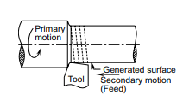
GENERATING AND FORMING
Generating is where the required profile is obtained by manipulating the relative motions of the work piece and the cutting tool edge. Thus the obtained contour would not be identical to the shape of the cutting tool edge. This is generally used for a majority of the general profiles required. The type of surface generated depends upon the primary motion of the work piece as well as the secondary (feed) motion of the cutting tool.
For example, when the work piece is rotated and a single point tool is moved along a straight line parallel to the axis of rotation of the work piece, a helical surface is generated. If the pitch of the helix (feed rate) is extremely small then the surface generated may be approximated to a cylinder. This is carried out in lathes and called turning or cylindrical turning.

Slide 8
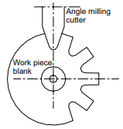
Forming in which the shape of the cutting tool is impressed upon the work piece. Thus the accuracy of the shape obtained is dependent upon the accuracy of the form of the tool used. However many of the machine tool operations are actually combinations of the above two.
For example, when a dove tail is being cut, the actual profile is obtained by sweeping the angular cutter along the straight line. Thus, it involves forming (angular cutter profile) and generating (sweeping along a line)

Slide 9
BASIC ELEMENTS OF MACHINE TOOLS
Work holding device: To hold the work piece in the correct orientation to achieve the required accuracy in manufacturing, e.g. chuck
Tool holding device: To hold the cutting tool in the correct position with respect to the work piece and provide enough holding force to counteract the cutting forces acting on the tool, e.g. tool post
Work motion mechanism: To provide the necessary speeds to the work piece for generating the requisite surface, e.g. head stock
Tool motion mechanism: To provide the various motions needed for the tool in conjunction with work piece motion in order to generate the different surface profiles as desired, e.g. carriage
Support structure: To support all the mechanisms as shown above and maintain their relative position with respect to each other and also allow for relative movement between the various parts to obtain the requisite part profile and accuracy, e.g. bed

Slide 10
MACHINE TOOL DRIVES
To obtain a machined part by a machine tool, coordinated motions must be imparted to its working members.
These motions are either primary (cutting and feed) movements, which remove the chips from the WP, or auxiliary motions that are required to prepare for machining and ensure the successive machining of several surfaces of one WP or a similar surface of different WPs.
Principal motions may be either rotating or straight reciprocating.
In some machine tools, this motion is a combination of rotating and reciprocating motions.
Feed movement may be continuous (lathes, milling machine, drilling machine) or intermittent (shapers, planers).
stepped motions are obtained using belting or gearing.
Stepless speeds are achieved by mechanical, hydraulic, and electrical methods.

Slide 11
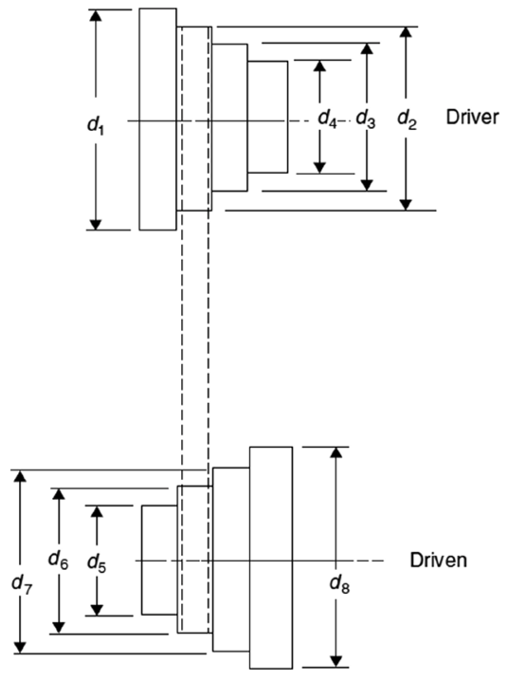
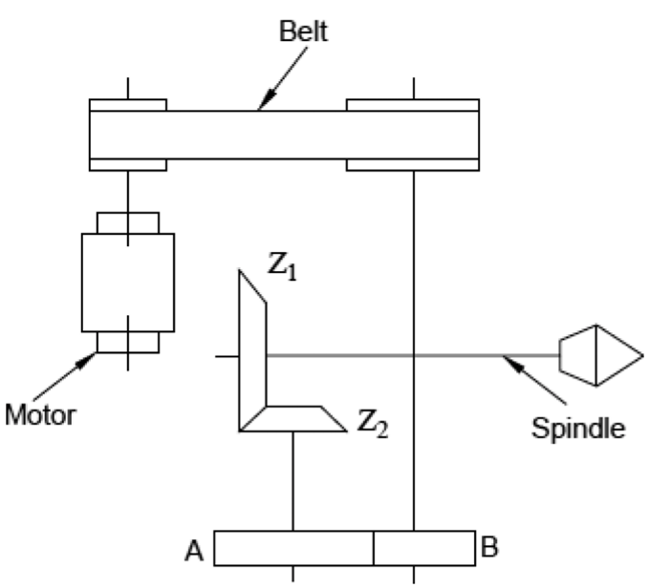
Stepped Speed Drives
1. Belting
It is used to produce four running rotational speeds
It is cheap and absorbs vibrations. It has the limitations of low-speed changing, slip, and the need for more space
This type is commonly used for grinding and bench-type drilling machines.
2. Pick-Off Gears
Pick-off gears are used for machine tools of mass and batch production (automatic and semiautomatic machines, special-purpose machines, and so on) when the changeover from job to job is comparatively rare. Pick-off gears may be used in speed or feed gearboxes. The change of speed is achieved by setting gears A and В on the adjacent shafts. As the center distance is constant, correct gear meshing occurs if the sum of teeth of gears A and В is constant.

Slide 12
3. Gear box
A wide variety of gearboxes utilize sliding gears or friction or jaw coupling.
The selection of a particular mechanism depends on the purpose of the machine tool, the frequency of speed change, and the duration of the working movement.
The advantage of a sliding gear transmission is that it is capable of transmitting higher torque and is small in radial dimensions.
Among the disadvantages of these gearboxes is the impossibility of changing speeds during running.
Clutch-type gearboxes require small axial displacement for speed changing and less engagement force compared with sliding gear mechanisms and therefore can employ helical gears.

Slide 13
Stepless Speed Drives
Infinitely variable speed (stepless) drives provide output speeds, forming infinitely variable ratios to the input ones. Such units are used for main as well as feed drives to provide the most suitable speed or feed for each job, thereby reducing the machining time.
They also enable machining to be achieved at a constant cutting speed, which leads to an increased tool life and ensures uniform surface finish. The easy and smooth changing of the speed or feed, without stopping the machine, results in an appreciable reduction in the production time, which increases the productivity of the machine tool.
Stepless speed drives may be mechanical, hydraulic, or electric. The selection of the suitable drive depends on the purpose of the machine tool, power requirements, speed range ratio, mechanical characteristics of the machining operation, and cost of the variable speed unit. In most stepless drives, the torque transmission is not positive. Their operation involves friction and slip losses. However, they are more compact, less expensive, and quieter in operation than the stepped speed control elements. Mechanical stepless drives include the following types.

Slide 14
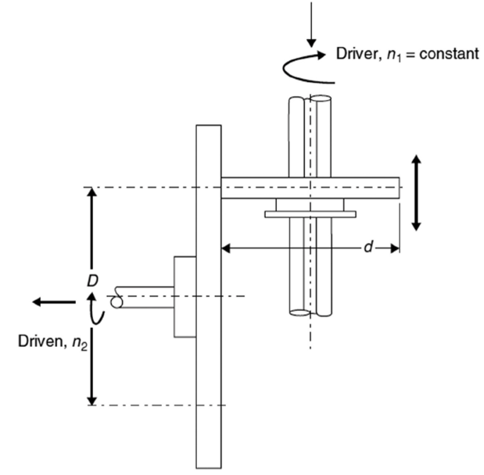
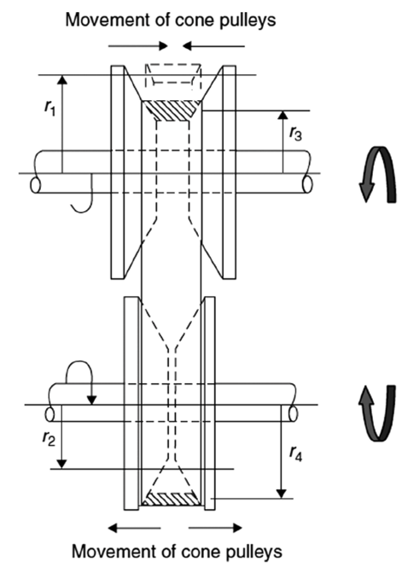
Friction Stepless Drive
Figure shows the disk-type friction stepless mechanism. Accordingly, the drive shaft rotates at a constant speed, as well as the friction roller of diameter d. The output speed of the driven shaft rotates at a variable speed n₂ that depends on the instantaneous diameter D.
Due to the small contact area, a certain amount of slip occurs, which makes this arrangement suitable for transmitting small torques and is limited to reduction ratios not more than 1:4
2. Toroidal and Reeves Mechanism
consists of a pair of pulleys connected by a V-shaped belt; each pulley is made up of two conical disks. These disks slide equally and simultaneously along the shaft and rotate with it.
To adjust the diameter of the pulley, the two disks on the shaft are made to approach each other so that the diameter is increased or decreased. The ratio of the driving diameter to the driven one can be easily changed, and therefore, any desired speed can be obtained without stopping the machine. Drives of this type are available with up to 8:1 speed range and 10 hp capacity.

Slide 15
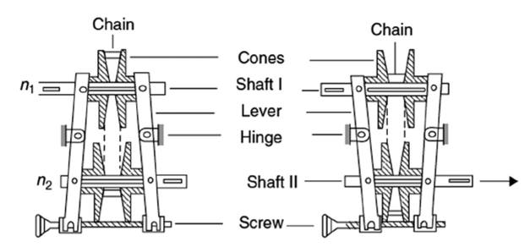

Slide 16
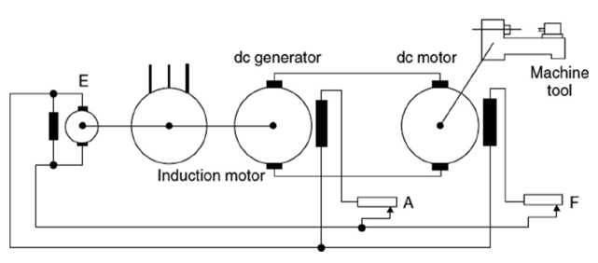
3. Electrical Stepless Speed Drive
which consists of an induction motor, which drives the direct current (dc) generator, and an exciter (E).
The dc generator provides the armature current for the dc motor, and the exciter provides the field current; both are necessary for the dc motors that drive the machine tool.
The speed control of the dc motor takes place by adjusting both the armature and the field voltages by means of the variable resistances A and F, respectively. By varying the resistance A, the terminal voltage of the dc generator and hence the rotor voltage of the dc motor can be adjusted between zero and a maximum value.
The Leonard set has a limited efficiency: it is large, expensive, and noisy. Nowadays, dc motors and thyristors that permit direct supply to the dc motors from an alternating current (ac) mains are available, and therefore, the Leonard set can be completely eliminated. Thyristor feed drives can be regulated such that the system offers infinitely variable speed control.
Leonard set (electrical stepless speed drive).

Slide 17
4. Hydraulic Stepless Speed Drive
The speeds of machine tools can be hydraulically regulated by controlling the oil discharge circulated in a hydraulic system consisting of a pump and hydraulic motor, both of the vane type. This is achieved by changing either the eccentricity of the pump or the eccentricity of the hydraulic motor or both.
The vane pump, running approximately at a constant speed, delivers the pressurized oil to the vane-type hydraulic motor, which is coupled to the machine-tool spindle. Speed control in hydraulic circuits can be accomplished by throttling the quantity of fluid flowing into or out of the hydrocylinders or hydromotor. The advantages of a hydraulic system are as follows:
1. Has a wide range of speed variation
2. Changes in the speed can be easily performed
3. Provides smooth and quiet operation
4. Ensures self-lubrication
5. Has automatic protection against overloads
The major drawback of a hydraulic system is that the operation of the hydraulic drive becomes unstable at low speeds. Additionally, the oil viscosity varies with temperature and may cause fluctuations in feed and speed rates.

Slide 18
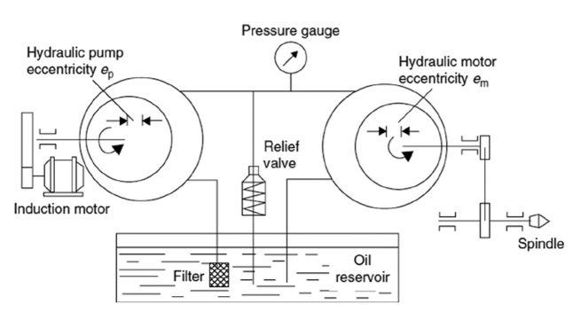

Slide 19
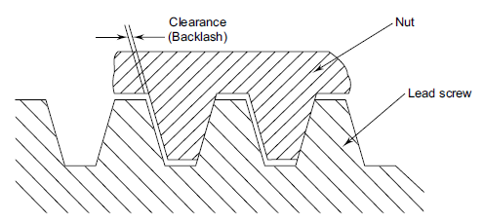
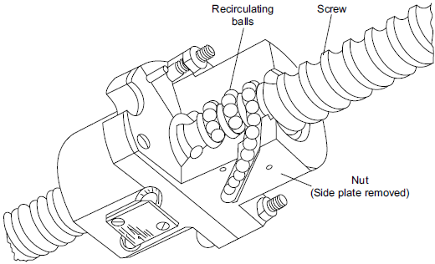
Lead Screws
The rotary motion from the drive motor needs to be converted to linear motion to move the various axes of the machine tool.
In conventional machine tools, the square (Acme) thread is normally used for this purpose. However, in view of the metal-to-metal sliding contact between the nut and the screw, the friction is very high. This results in greater power being utilised for the movement of the axes.
most of the higher end machine tools use a lead screw with a recirculating ball nut.
In the case of recirculating ball screws, the nut is replaced by a series of balls, which circulate in the channel in the form of threads
This results in a highly efficient rolling motion of balls in the space between the screw shaft and nut. The balls at the end of the thread portion in the nut will be re-positioned into the beginning of the thread form by a deflector

Slide 20
GUIDEWAYS (SLIDEWAYS)
Guideways (slideways) are linear bearings for translatory movement between two members of a machine tool, such as carriage and bed in a lathe. They should provide
alignment and fit
ample load carrying capacity
absence of stick-slip jerk
adjustment for wear and lubrication
The requirements of the guideways are:
High accuracy
High surface finish
Low value of frictional force
Low wear rate

Slide 21
A close grained material is used along with inclusion of alloying elements. The bearing surfaces are flame and induction hardened for better wear characteristics
The types of guideways may be classified as
Guideways with sliding friction also termed as slide ways.
Guideways with rolling friction also termed as anti-friction ways. In this there are two varieties with balls or rollers as anti-friction elements.

Slide 22
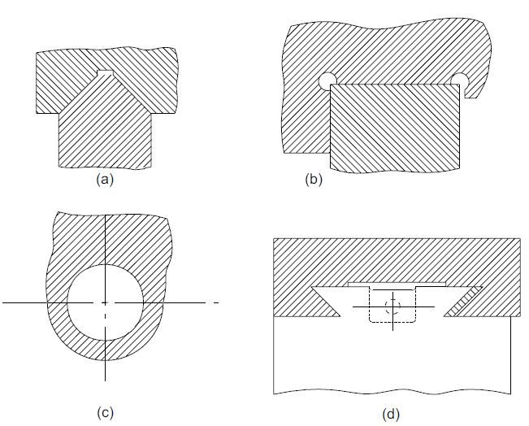
TYPES OF SLIDEWAYS
There are a number of types of slideways conventionally used in machine tools
(a) V-slideways
(b) Flat slideways
(c) Round slideways
(d) Dovetail slideways

Slide 23
The shape of slideway depends basically upon the function it is expected to serve. The following are some guiding principles in identifying the shape of a slideway.
load carrying capacity
ease of manufacture
ease of chip disposal
effective lubrication
position of slideway
V-SLIDEWAYS
They can adjust clearances under the weight of the moving member. Machining accuracy is not greatly affected by the wear of guideways. The chips would not clog the slideways. However, they are difficult to manufacture and provide very small bearing area. They can be symmetrical or more generally asymmetric
Symmetrical is good when the acting load is perfectly vertical since the load will be equally distributed among the faces of V. However in metal cutting, we have seen that tangential force is more compared to radial force. Thus, in asymmetrical V, the longer face is normally made perpendicular to the direction of the resultant force. This allows for uniform wear in both the faces.

Slide 24
FLAT SLIDEWAYS
Flat slideways are easier to manufacture and are able to provide a large amount of bearing area. However, the locational accuracy and other advantages provided by the V-slideways are missing. Hence the flat slideways cannot be used on their own, but in conjunction with the V-slideways.
ROUND SLIDEWAYS
Round slideways are kinematically sound since they constrain all possible motions except the direction required, but are only used in vertical type of machines such as drilling (radial and pillar). Main reasons for their non-acceptance are:
low rigidity
difficulties in manufacture to the given accuracy
difficulties in assembling and the resultant accuracy in motion

Slide 25
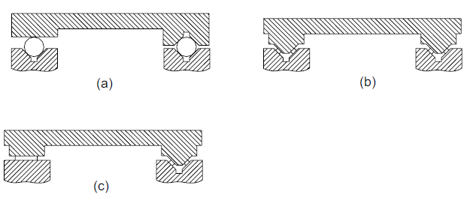
DOVETAIL SLIDEWAYS
Dovetail slideways are compact, but difficult to manufacture. These are generally used for vertical movement and where space is at a premium. However they provide good rigidity and alignment. Dovetails are generally used in carriage of lathe, for moving knee of a milling machine.
Anti-friction Slideways
The anti-friction guideways involve intermediate rolling members (balls or rollers) between the sliding members, thus reducing the friction
The use of anti-friction guideways because of the low friction during motion, and high stiffness, will provide very high velocities possible for slideway movement. These are generally used in high precision machine tools.

Slide 26
MACHINE TOOL TESTING

Slide 27
MEASURING INSTRUMENTS USED FOR TESTING
Dial indicators: This is the most common instrument used for measuring the accuracy of the machine tool elements. A least count of 0.01 mm is generally sufficient for carrying out the tests. The plunger pressure should not be too low, which may interfere with some measurements involving the swing over, where the dial indicator may have to be in an inverted position. The dial indicator should be fixed to a rigid base with a sufficiently large and flat bearing surface.
Test mandrels: Test mandrels of large variety are used in machine tool testing for various purposes. As a result, the quality of the test mandrel is important. The roundness and straightness of the mandrel is important for measuring various accuracies. In case of large length mandrels, careful consideration will have to be given to the deflection of the mandrel due to its own weight while testing. It may therefore be desirable to have hollow mandrels for large lengths. The diameter of the mandrel may have to be increased to improve the rigidity of the mandrel. The measuring length of the mandrel may vary from 100 mm to 500 mm for most cases

Slide 28
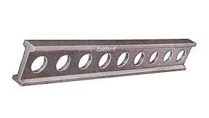
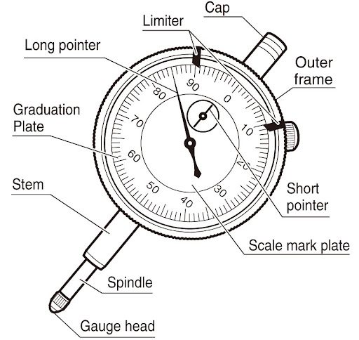
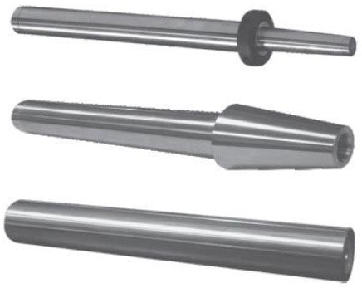
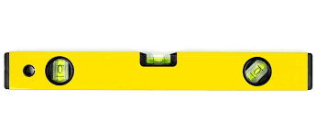
Straight edges: Heavy and internal stress free straight edges of sufficient length made of steel or cast iron would be used. They should have sufficiently large bearing area and ground to close tolerances with squareness of the order of ± 0.01 mm.
Spirit levels: Before carrying out the machine tool tests it is necessary to level the machine tool both in the longitudinal direction as well as the lateral direction. For this purpose, the spirit levels are used. The spirit level with sensitivity of the order of 0.01 mm per metre length would be sufficient.

Slide 29
TEST PROCEDURES
The major tests that are to be conducted on the machine tools are:
Testing the quality of the slideways and the locating surfaces,
Testing the accuracy of the main spindle and its alignment with respect to other parts of the machine tool, and
The accuracy of the parts produced by the machine tool.
Before the tests are conducted it is important to ensure that the machine tool is at the normal working temperature in order to establish the accuracy of the machine tool in the normal working conditions.
For this purpose the machine tool should be run for a period (at least 30 minutes) which will bring all the bearing surfaces and spindles to the normal working temperature.
The test when conducted under this condition will reflect the actual accuracy that can be ensured throughout its working range.

Slide 30
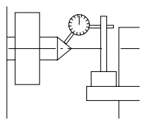
1. Quality of Slideways
To test the quality of the slideways, it is necessary to mount the dial indicator on a good datum surface. Then the plunger is moved along the longitudinal direction of the slideways, which will provide an indication of the undulations present on the surface of the slideways. The readings can be taken at fixed intervals (at least 10) along the length
2. Accuracy of Spindle
These tests are related to the true running of the spindle and the centre located in the spindle along with the alignment, parallelism and perpendicularity of the spindle with the other axes (slideways) of the concerned machine tool.
True Running of the Centre
The live centre may be loaded into the lathe spindle and a dial indicator is mounted as shown in Fig. 13.1. This test is required only for the machines where the work piece is held between centres. The readings of the dial indicator are taken while rotating the spindle through a full rotation
Test setup for true running of the centre in the lathe spindle

Slide 31
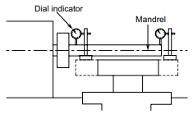
True Running of the Spindle
Taper shank of the test mandrel of about 300 mm in length is mounted into the spindle as shown in Fig. for a lathe. The plunger of the dial indicator rests on the cylindrical surface of the mandrel. The spindle is rotated slowly and the readings of the dial indicator are noted. The deviation should normally be less than 0.01 mm. The test is to be repeated with the dial indicator positioned close to the spindle bore as well as at the extreme end of the test mandrel. This test is to be carried out on all machines, which have the main running spindle.
Test setup for true running of the spindle of a lathe

Slide 32
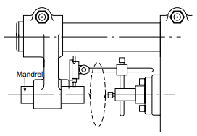
Alignment Tests
These tests relate to the relative position of the spindle axis with the other axes of the machine tool
Spindle Alignment
In this test, the dial indicator is mounted on one of the surfaces whose alignment is to be tested with another surface. For example, in the case of a horizontal axis milling machine, the testing of the alignment between the spindle and the over arm support can be done. The dial indicator is mounted on the spindle while a test mandrel will be mounted in the over arm support with the plunger of the dial indicator resting on the cylindrical surface of the test mandrel. The spindle is rotated and readings are taken when it is at different positions on the periphery of the test mandrel. The test may be conducted at the two extreme ends of the mandrel.
Test setup for the spindle alignment of a milling machine with that of the over arm support

Slide 33
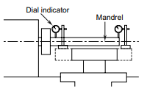
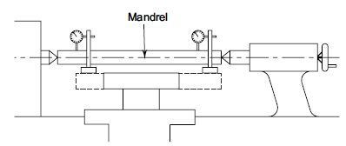
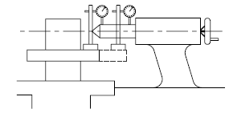
Parallelism and Perpendicularity
Parallelism or perpendicularity between two axes or two surfaces is normally to be measured in two planes, horizontal and vertical. For this purpose the test mandrel is mounted in the spindle for the lathe with the dial indicator mounted on the saddle or carriage. The plunger of the dial indicator touches the mandrel surface. The saddle is moved for a specified distance and the dial reading is noted. The test is to be repeated in the horizontal direction as well.
Test setup for parallelism between the spindle axis and the slideways in a lathe
Test setup for the parallelism of the tail stock sleeve
Test setup for the parallelism of the line of centres in a lathe

